Slide 1
From Nature to the Artist’s Page
Birds and Animals in Indian Art through the collection of National Museum, New Delhi

Slide 2
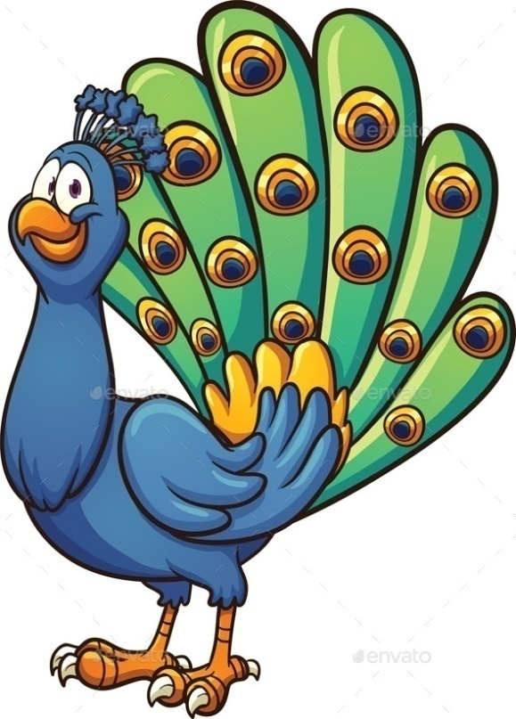
I AM A TIGER
Courtesy: clipartlord.com
Courtesy: graphicriver.net
We are very special to India. Do you know why?
I AM A PEACOCK
Come With Us To Know More About our bothers and sisters!

Slide 3
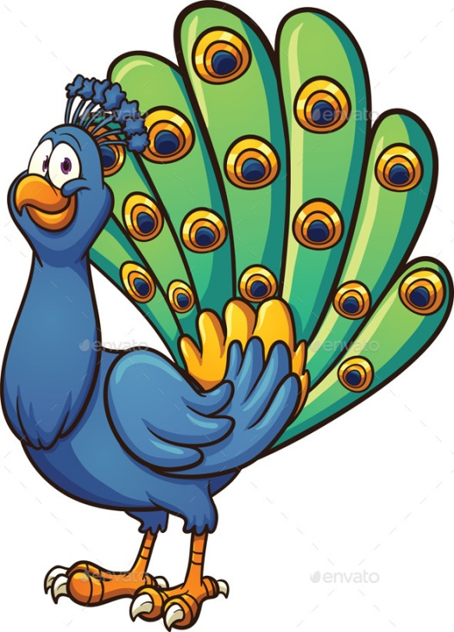
From the ancient of days, birds and animals have been a part of Indian Art.
Paintings, Sculptures and Architecture – all were decorated with animals and birds found in nature.
We were a part of Indian myths and stories, religion and even day-to-day life!

Slide 4
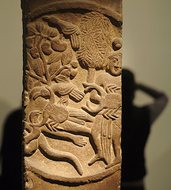
The human storytellers gave us different emotions, even made us talk like humans!
Can you think of any story that as animals or birds as heroes and heroines?
Do you know this one?
Collection of NM, New Delhi
Suvarnakatkata Jataka

Slide 5
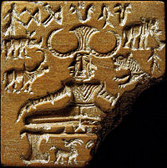
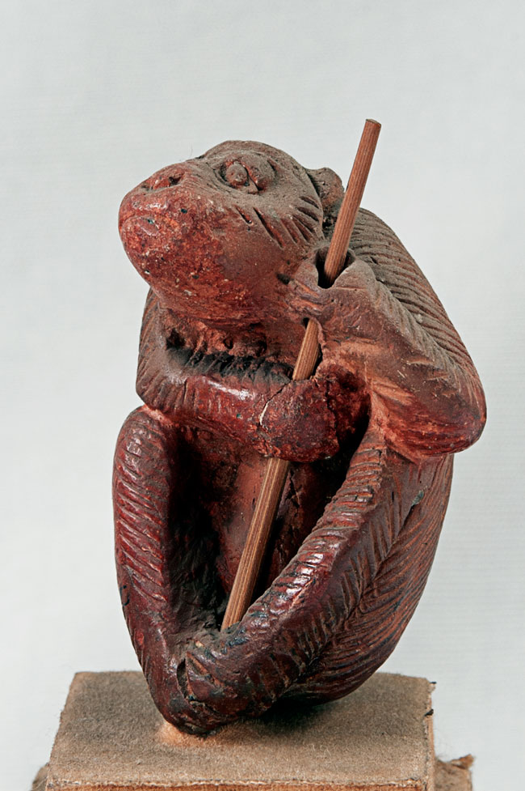
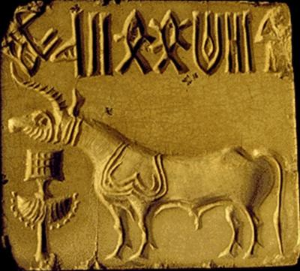
Earliest Animals Depicted in the Indian Subcontinent
WHAT ARE THEY?
WHERE ARE THEY FROM?
WHAT ARE THEY MADE OF?
WHAT PURPOSE DID THEY SERVE?
Collection of NM, New Delhi

Slide 6
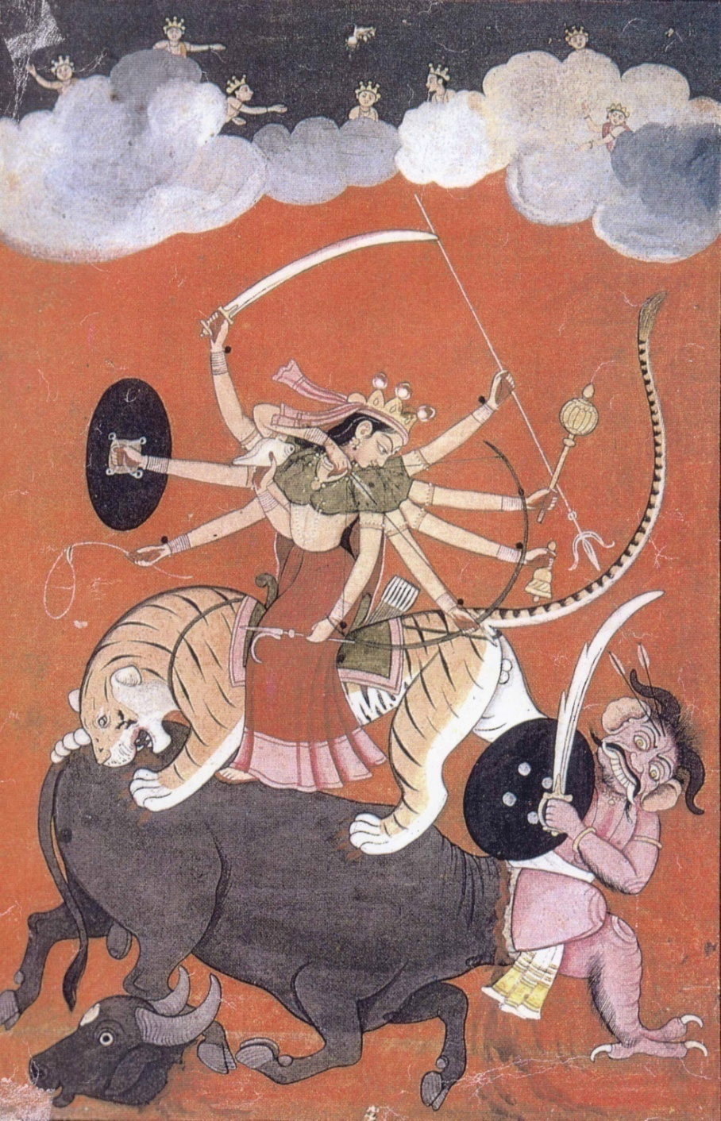
Animals were part of our ancient myths and legends.
Why does every Hindu God/Goddess has an animal as the mount?
Collection of NM, New Delhi

Slide 7
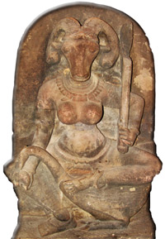
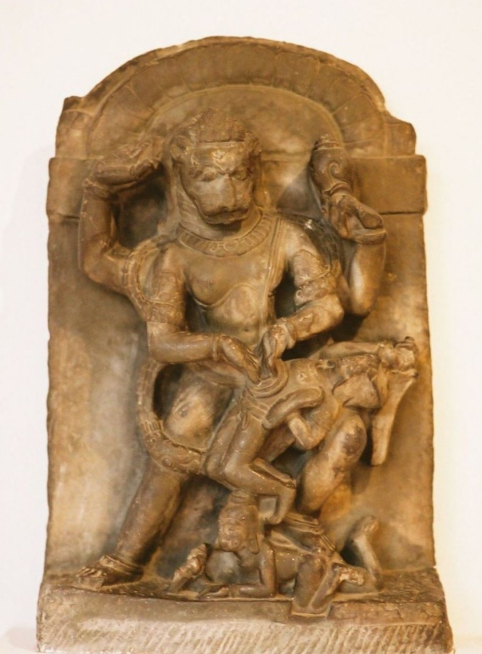
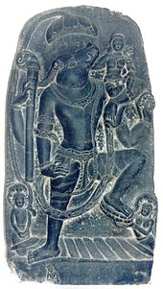
Some Hindu deities have birds and animals as mounts. But some others are partly human and partly animal.
Why did our ancestors imagine our Gods this way?
Collection of NM, New Delhi

Slide 8
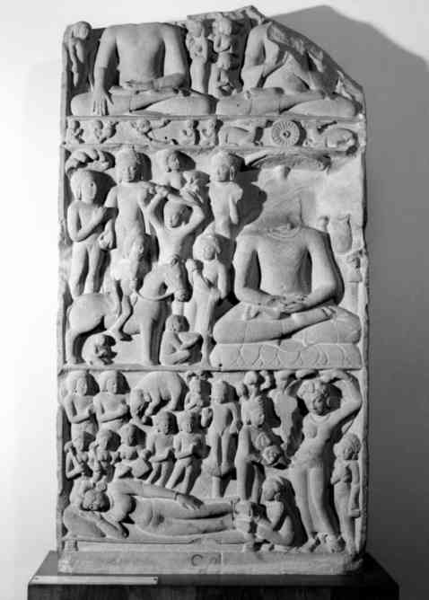
Animals and Birds figure very prominently in Buddhist Jataka stories. They are also important part of stories from Gautama Buddha's life.
What are the Jatakas?
How many animals or birds can you find in this panel? Do you know what they depict?
Collection of NM, New Delhi

Slide 9
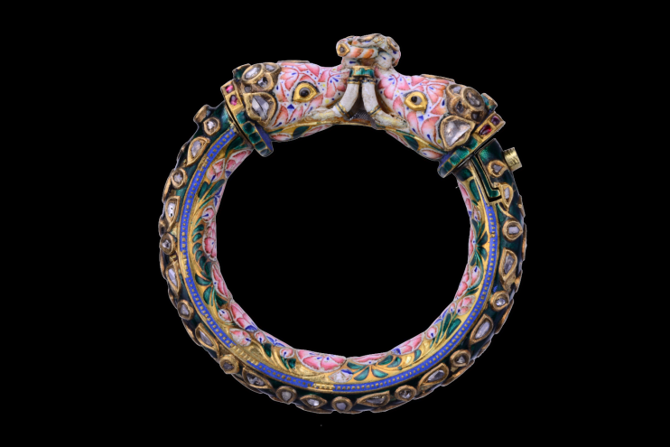
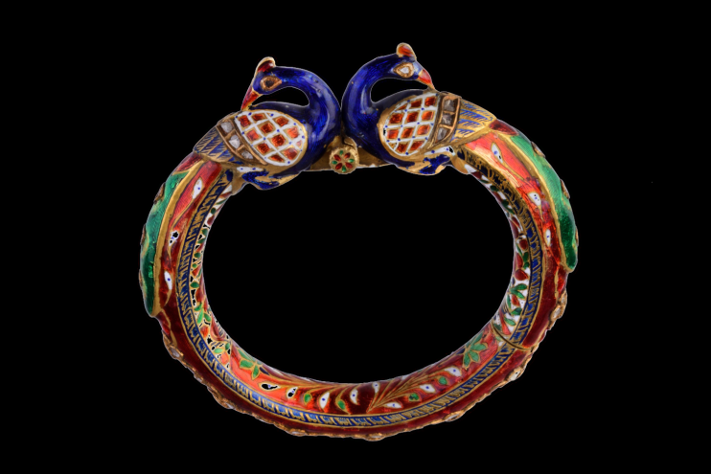
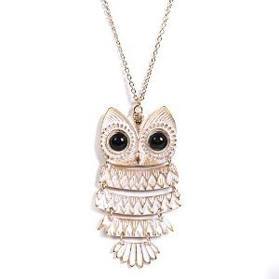
Why did our ancestors use animals and bird in jewellery? Were they considered auspicious? Were they part of an interesting story?
Collection of NM, New Delhi
Don’t we still have jewellery with birds like the Owl?
Courtesy: amazon.com

Slide 10
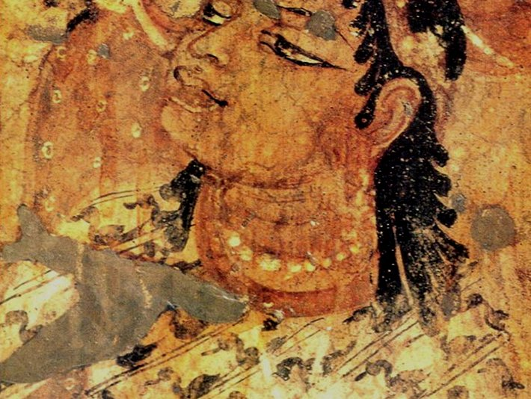
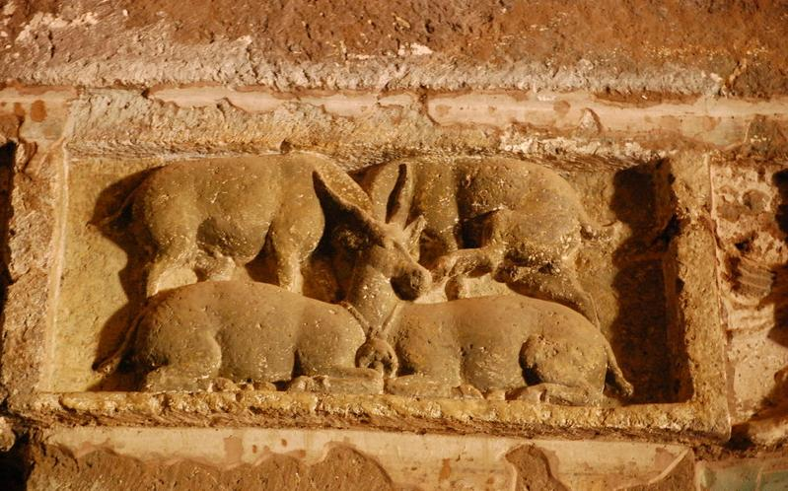
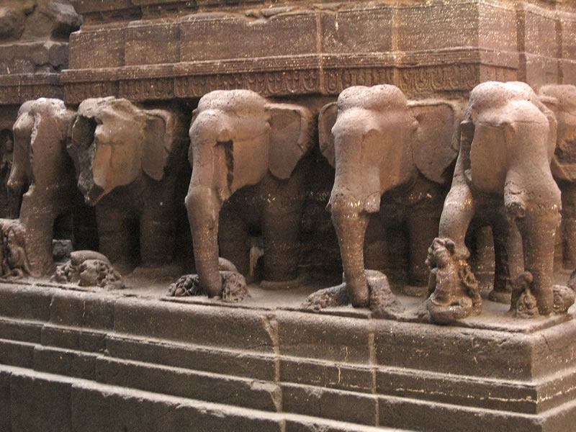
Birds and Animals in Architecture
Birds, Animals and plants were variously depicted as ornaments and symbols in architecture – both religious and secular.
Peacocks guarded palace doors and elephants paraded around temples!
Where are these from?
Courtesy: indianheritage.org
Courtesy: maharajaexpress.com
Courtesy: weburbanist.com

Slide 11
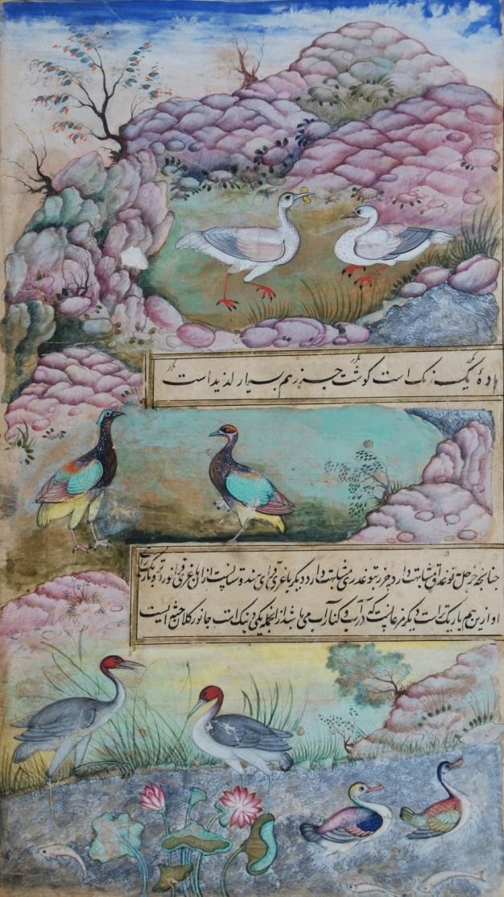
Birds and Animals in Paintings
The Mughal rulers commissioned beautiful and detailed studies of birds and animals.
Who made these studies? And why?
Collection of NM, New Delhi

Slide 12
One Body, Many Animals
How many animals and birds do you see?
Why were they made?
Collection of NM, New Delhi

Slide 13
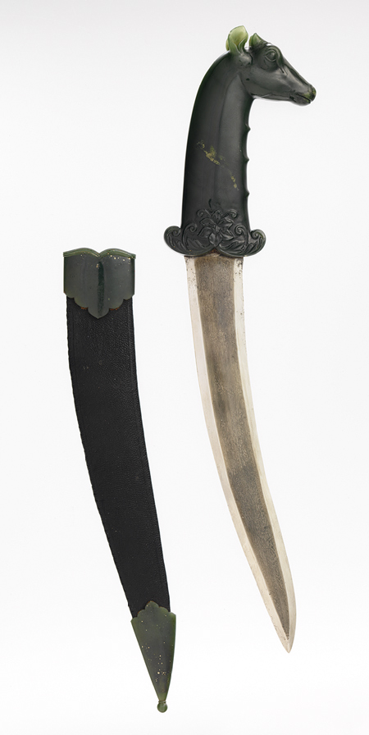
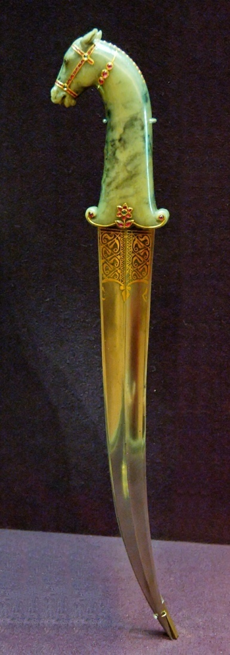
Birds and Animals in Indian Arms
Why should Arms and Armoury be left behind? Many birds and animals came to ornament various arms and weapons too!
They not only looked pretty, but also had spiritual and symbolical meanings.
Why is the horse used with a dagger, and not some other animal like a rabbit?
Collection of NM, New Delhi

Slide 14
Want to know more about animals and birds in Indian Art?
You can read these books, and look for many more on your own!
Krishnamurthy, K. Mythical Animals in Indian Art. Abhinav Publications, 1985.
Khannam, Zahida. Birds and Animals in Mughal Miniature Painting. D. K. Printworld, 2009.
Sivaramamurti, C. Birds and Animals in Indian Sculpture. National Museum, 1974.

Slide 15
Department of Lecturing and Education
National Museum, New Delhi
Visit the main Museum website
www.nationalmuseumindia.org

